Slide 1
SMACUMED International Conference on Water-Energy-Food-Ecosystem Nexus in the Mediterranean Region
(WEFE 2023)
Synthesis of Activated Carbon/Sodium Alginate Composites for Wastewater Treatment
By Yaacoubi Fatima Ezzahra
PhD candidate
Laboratory of applied chemistry and biomass
Department of chemistry,
Faculty of sciences Semlalia-Marrakesh (FSSM)

Slide 2
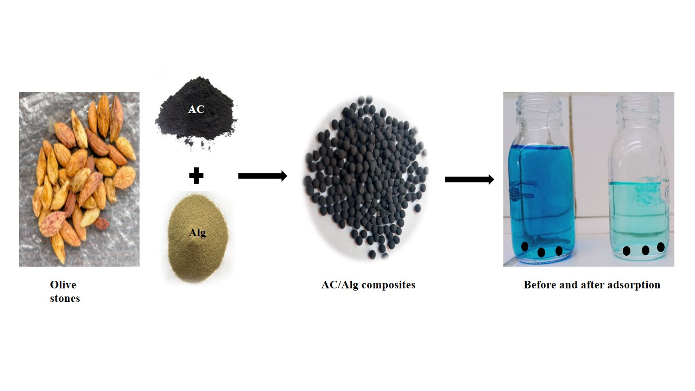
INTRODUCTION
WEFE2023
Valorization of biomass derived from local lignocellulosic agricultural waste
Chemical analysis (%)
Lignin | 37.8
Hemicellulose | 19.7
Cellulose | 17.8
Volatile | 70.5
Ash | 2.25
Fixed Carbon | 20.2

Slide 3
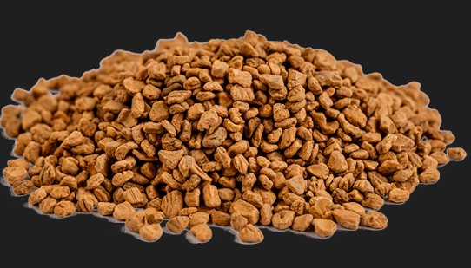
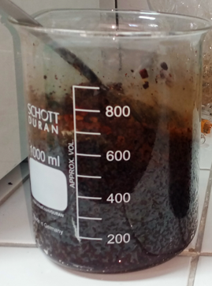
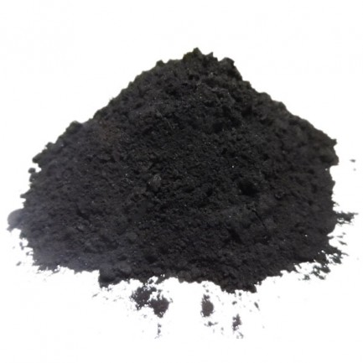
Materials & methods
WEFE2023
Preparation of activated carbon by chemical activation
1. Impregnation of biomass using KOH
2. One-step activation
$$T_{a}=700±2,$$
$$t_{a}=30min,$$
$$∅_{N_{2}}=100 ml/min$$
Washing and Drying

Slide 4
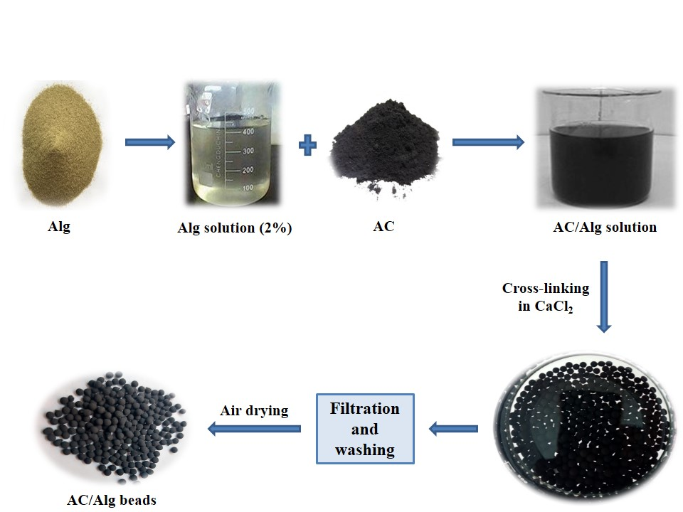
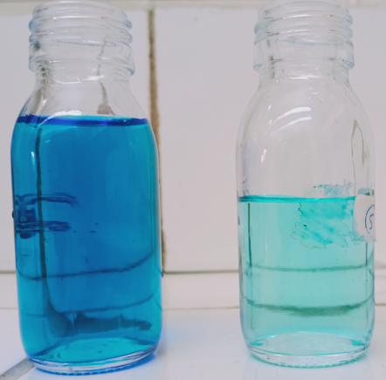
Materials & methods
WEFE2023
Preparation of activated carbon/sodium alginate (AC/Alg) composites

Slide 5
Materials & methods
WEFE2023
characterization
SEM analysis
Surface area (m²/g) | Average pore size (nm) | Pore volume (cm³/g)
374.82 | 1.40 | 0,131
BET analysis
pH at the zero point of charge
$${pH}_{zpc}=5$$
Conducted on beads before and after MB adsorption
FTIR spectra

Slide 6
Results & discussion
WEFE2023
Infrared spectroscopy analysis is performed on AC/Alg composites before and after MB adsorption
All adsorption tests were performed at a pH of 6, higher than the ${pH}_{zpc}$, using 10mg of the adsorbent material per 100 ml of methylene blue solution.

Slide 7
Results & discussion
WEFE2023
Modelization
Adsorption kinetics
Adsorption isotherms
The adsorption kinetics of MB follows the pseudo-1st order model, with a Q_{max} of 586 mg/g according to the Langmuir model

Slide 8
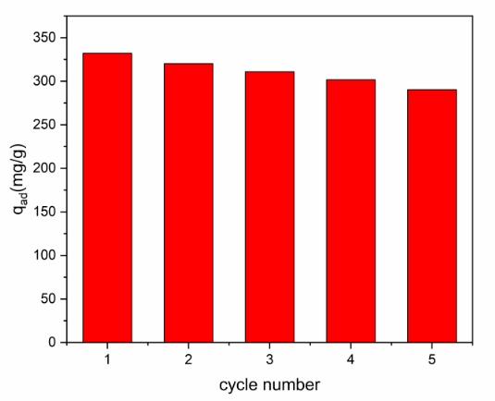
Results & discussion
WEFE2023
Reusability tests
The beads were carefully washed with 0.1 M of hydrochloric acid to remove the adsorbed dye molecules;
This adsorption and washing cycle was repeated for a total of 5 cycles.

Slide 9
Conclusion
WEFE2023
this study contributes to the understanding of the adsorption behavior of methylene blue and the potential application of AC/Alg-Na composites as effective and reusable adsorbents.
Approximately 60% of methylene blue was removed while reaching a maximum adsorption capacity of 586 mg/g according to the Langmuir model

