Slide 1
AI4TB
State of Advancement
Presented by : Manal Karmoude
Submitted at : 19/12/2024

Slide 2
Dataset :
Class Distribution:
Normal Cases: 🟢 3,500 images "These represent healthy individuals with no signs of tuberculosis."
Tuberculous Cases: 🔴 700 images "Images of individuals diagnosed with tuberculosis, highlighting areas of infection."

Slide 3
Dataset :
Preprocessing Pipeline for Chest X-ray Dataset :
Resizing:
All images are resized to 224x224 to standardize input dimensions for the ResNet model.
Normalization:
Applied per-channel normalization with:
Mean: [0.5, 0.5, 0.5]
Standard Deviation: [0.5, 0.5, 0.5]

Slide 4
Dataset :
Class Imbalance Handling:
Class Weights:
Normal: 1/3500
Tuberculous: 1/700

Slide 5
Model Architecture :
Pretrained Model:
Base Model: ResNet-34
Base Model : ResNet-18
Modified for Binary Classification:
Final Fully Connected Layer adjusted to classify:
Normal
Tuberculous

Slide 6
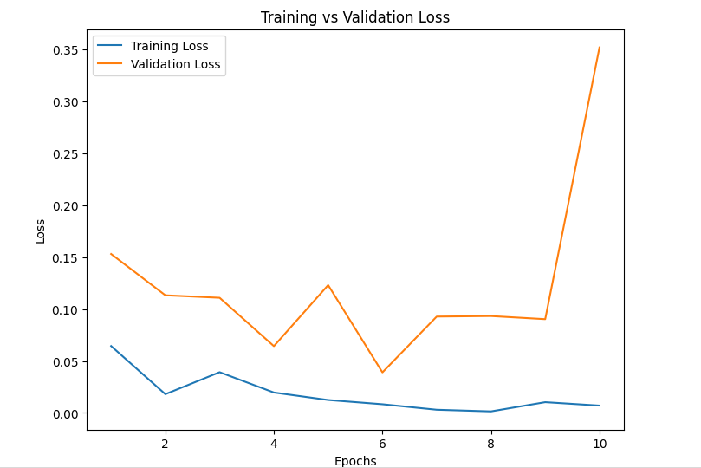
Model ResNet34 :

Slide 7
Model ResNet34 :
Batch Size | Epochs | Class Imbalance | Validation Loss | Validation Accuracy
32 | 10 | Addressed using Class Weights (Normal: 1/3500, Tuberculous: 1/700) | 0.0430 | 99.29%

Slide 8
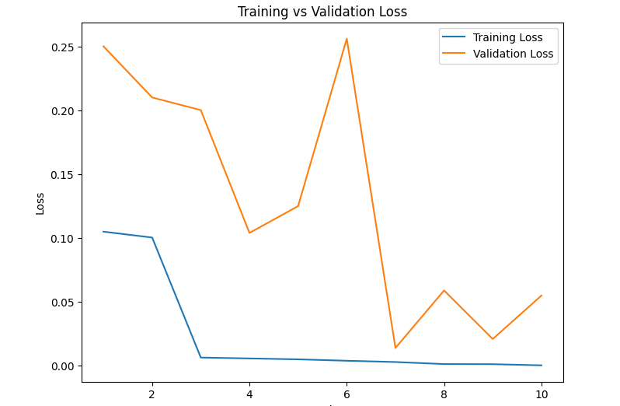
Model ResNet18 :

Slide 9
Model ResNet18 :
Batch Size | Epochs | Class Imbalance | Validation Loss | Validation Accuracy
32 | 10 | Addressed using Class Weights (Normal: 1/3500, Tuberculous: 1/700) | 0.0076 | 95.32%

Slide 10
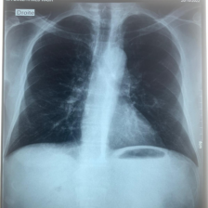
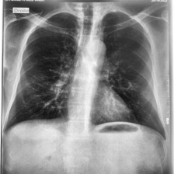
Apply CLAHE (Contrast Limited Adaptive Histogram Equalization) :

