Slide 1
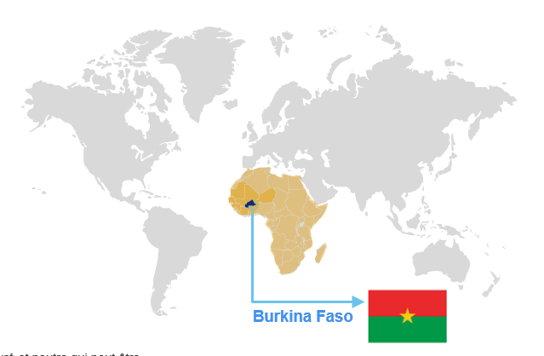
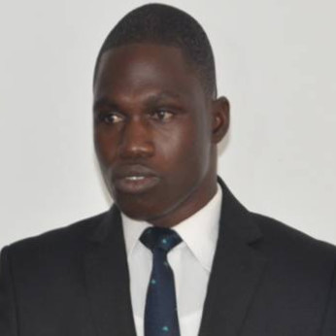
The benefits of Mycobacterium tuberculosis complex phylogeny and artificial intelligence tools for anti-tuberculosis drug resistance detection and genomic surveillance
TB: preventable and curable disease,
affects typically lungs. Caused by MTB complexe
1.3
01
What?
10.8 millions cases in 2023
and 1.25 million estimated deaths
175 923 diagnosed as MDR/RR-TB;
44% of the 400 000 estimated to have developed MDR/RR-TB in 2023 (Global TB report 2024)
02
How much?
Great advances on diagnostics and treatment
MDR/RR-TB Serious treat nowadays
Spread of isolates resistants can link to lineages
Why?
03
Project team members
Dr. Abdou Azaque ZOURE, Msc, PhD, PhD Associate Professor, Institut de Recherche en Sciences de la Santé (IRSS/CNRST)-Burkina Faso
Dr. Tani SAGNA, Msc, PhD, Associate Professor, Institut de Recherche en Sciences de la Santé (IRSS/CNRST)-Burkina Faso
Wendémi Alexis SAMA, Msc,
PhD student/Joseph Ki-Zerbo university- Burkina Faso
04
Which lineages circulates in BF?
We want to conduct WGS of MTBc to describe genetic structure and early detection of genomic resistance
objective
05
Clinical Samples collection (sputum)
Performing of WGS and bioinformatics analysis
How?
Phylogenetic tree of isolates in BF is constructed
Prevalence of genomic resistance is known
MTB complex lineages are described
Expected results
06

Slide 2
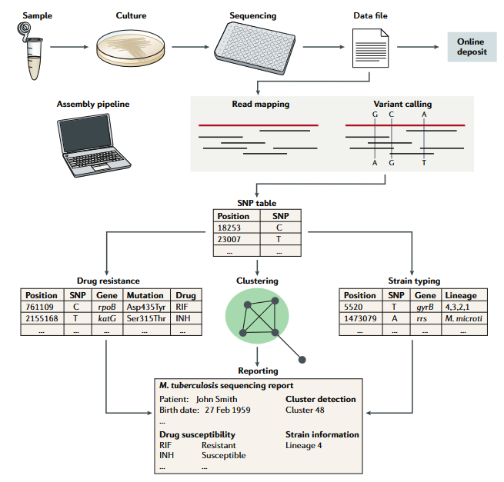
Our main activities
2/3
01
Protocol writing
Writing of a systematic review
02
Sample collection
Bacteriological culture
DNA extraction and sequencing
03
AI model to predict the distribution and the spread of lineages in the world
04
Bioinformatics analysis
Data analysis
Papers writing and publishing
Fig 1: Standard woekflow
For WGS of MTB complex isolates
(Conor J. Meehan et al., 2019)
05
Dissemination of results to stakeholders
Thesis defense
The benefits of Mycobacterium tuberculosis complex phylogeny and artificial intelligence tools for anti-tuberculosis drug resistance detection and genomic surveillance

Slide 3
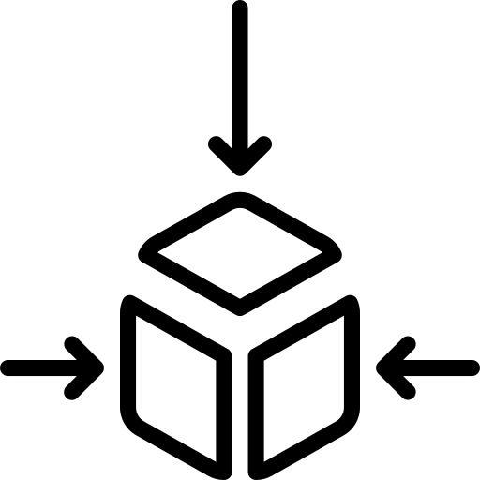
3/3
Project phases
The benefits of Mycobacterium tuberculosis phylogeny and artificial intelligence tools for anti-tuberculosis drug resistance detection and genomic surveillance
3 academics years (2023-2026)
2024
2025
2025/2026
2026
Data analysis
Bioinformatics analysis
Papers writing and publishing
AI model to predict the spread of lineages
Writing of a systematic review (ongoing)
Protocol writing (done)
Mobility internships related to WGS and bioinformatics
sample collection
Lab processing
Thesis instructions
Thesis defense
Dissemination of results to stakeholders

