Slide 1




Session
Spatio-Temporal Dynamics and Environmental Drivers of Leishmania major in Morocco (2003–2022): Insights from Epidemiological and Geospatial Approaches
¹Chaymaa HARKAT, ^{2,3}Denis SERENO, ¹Oussama RIDA, ¹Hicham HAFIANE, ^{4,5}Laila HOUMMADI ⁶Moulay Abdelmonaim EL HIDAN, ⁷Souad BOUHOUT, ¹Kholoud KAHIME
¹Cadi Ayyad University (UCA), Essaouira Higher School of Technology, Interdisciplinary Laboratory for Research in Environment, Management, Energy and Tourism (LIREMET), Av Abdelkrim Khattabi, B.P. 511 - 40000, Marrakech, Morocco
²IRD, University of Montpellier, UMR177, 34032, Montpellier Cedex, France
³GOINsEcT: Global Infectiology and Entomology Research Group, Montpellier Cedex, France
⁴Bio-resources and Food Safety laboratory, Faculty of Sciences and Techniques, Cadi Ayyad University, Marrakesh, Morocco
⁵Higher Institute of Nursing Professions and Health Techniques of Marrakesh, Morocco
⁶Laboratory of Biotechnology and Natural Resources Valorisation, Ibn Zoh University,Agadir, Morocco
⁷Department of Epidemiology and Disease Control, Ministry of Health and Social Protection, Morocco
16 – 18 Octobre 2025
Notes:
Good [morning/afternoon], everyone. My name is Chaymaa, and I am a third-year PhD student at the Higher School of Technology in Essaouira, Morocco. My research focuses on understanding how environmental risk factors shape the epidemiology and transmission of Leishmania major, one of the ten most significant neglected tropical diseases affecting Morocco. Today, I am honored to share with you the key findings from my research entitled …

Slide 2
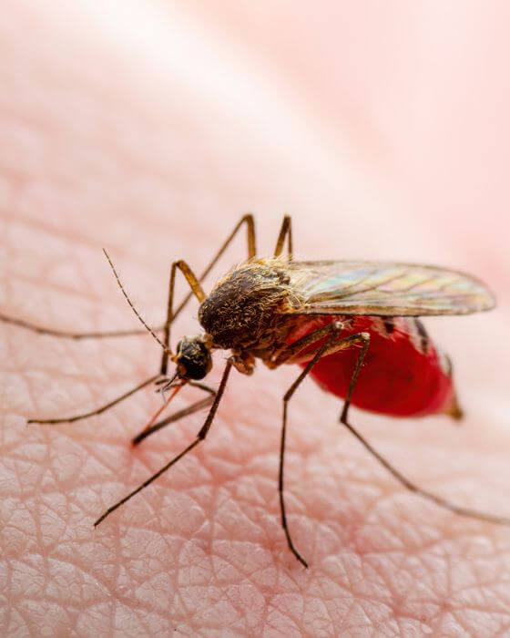
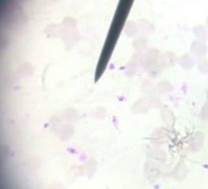
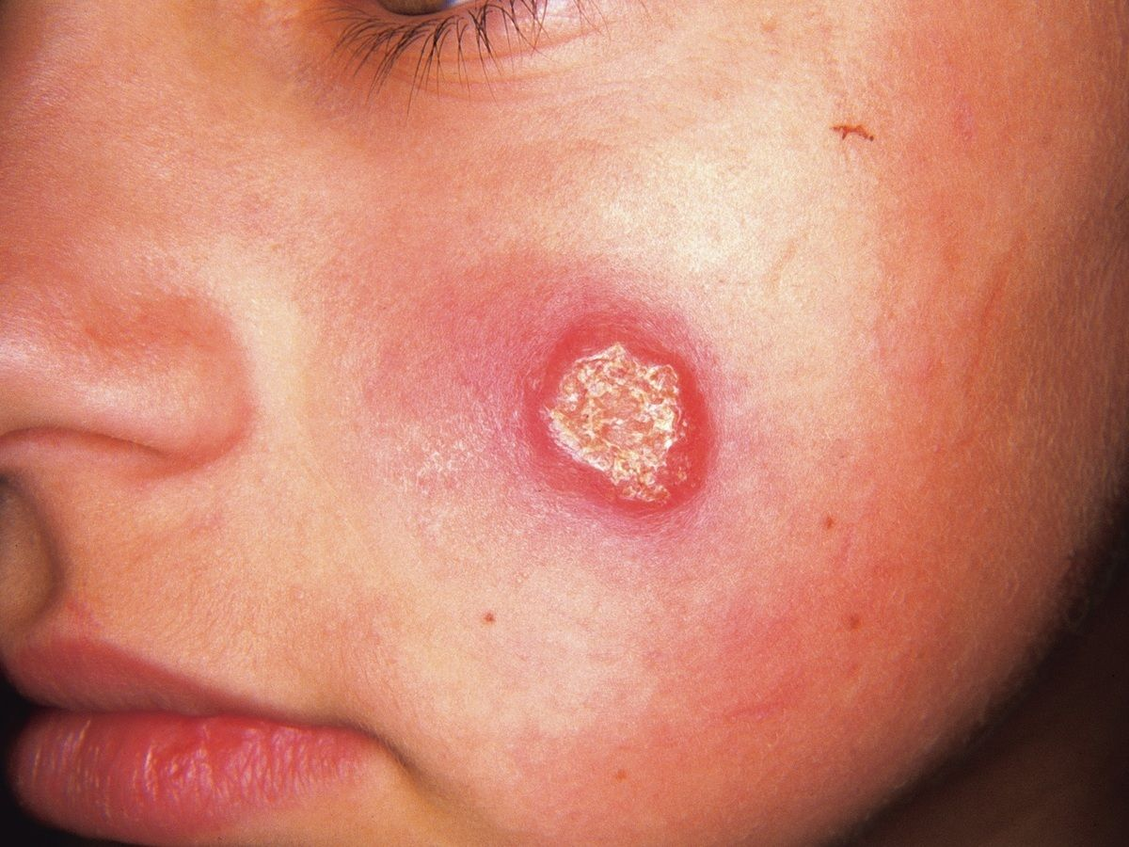
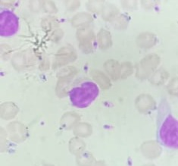
01
Introduction
Leishmania major is a protozoan parasite that causes zoonotic cutaneous leishmaniasis (ZCL), transmitted predominantly by the sand fly Phlebotomus papatasi.
It is endemic to arid and semi-arid regions, particularly in North Africa, the Middle East, and Central Asia, where it represents a major public health challenge.
Notes:
As is well known, Leishmania major is a protozoan parasite responsible for zoonotic cutaneous leishmaniasis (ZCL), which is predominantly transmitted by the sand fly Phlebotomus papatasi. Leishmaniasis represents a significant global public health challenge, as it is endemic in arid and semi-arid regions across approximately 100 countries, mainly located in North Africa, the Middle East, and Central Asia

Slide 3
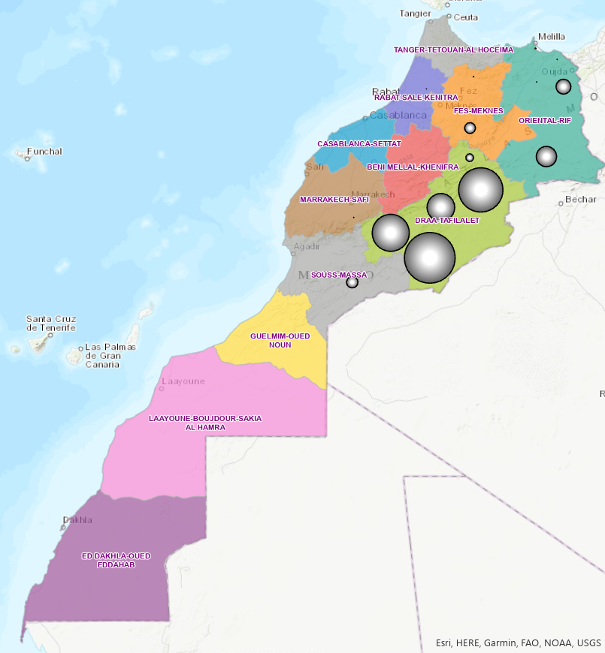
02
Problematic
According to the WHO, the incidence rate of CL is 5.62, with 14% of the population at risk.
Cutaneous leishmaniasis caused by Leishmania major continues to spread geographically in Morocco, particularly in the Southeast.
The role of certain environmental and social factors remains insufficiently explored and poorly understood.
Understanding the interactions among transmission factors and the disease dynamic is essential for strengthening prevention.
WHO. (2023) La Lutte Contre Les Leishmanioses. Report of the Meeting of the WHO Expert Committee on Leishmaniasis Control.World Health Organization.Weekly Epidemiological Record.
Notes:
According to the WHO, Morocco is among the countries most affected by cutaneous leishmaniasis, with Leishmania major being the main cause in the Southeast. Despite control efforts, the disease keeps spreading, and the impact of environmental and socio-economic factors is still not well understood.

Slide 4
01
02
03
04
Methodology
Results
Conclusion
Objectives
1. To analyze the spatiotemporal evolution of cutaneous leishmaniasis due to L. major in endemic areas, particularly in Southeastern Morocco.
2. To identify the environmental determinants associated with the transmission dynamics of L. major.
Notes:
To better understand this complexity, the objectives of our study aim to analyze the spatiotemporal evolution of cutaneous leishmaniasis caused by L. major in endemic areas, with a particular focus on Southeastern Morocco. Secondly, we seek to identify the key environmental determinants that influence this outbreak.

Slide 5
01
02
03
04
Methodology
Results
Conclusion
Objectives
1. Data collection :
Regional epidemiological data (annual number of cases)
Régions : Draâ-Tafilalet, Sous-Massa, Jerada and Boulemane
Environmental data (Altitude, NDVI)
Socio-demographic and economic variable data (Urbanization, Poverty rate and vulnerability rate)
2. Data preprocessing using machine learning
3. Spatio-temporal analysis by GIS (ArcMap version 10.8) Spatial mapping
4. Statistical correlation analysis (Rstudio) : Pearson Correlation using Rstudio software
Notes:
Our methodology is as following
First, we collected data including regional epidemiological cases, environmental factors such as altitude and NDVI, and socio-demographic and economic indicators like urbanization and poverty rate. Then, we cleaned and prepared the data using machine learning. Third, we performed spatio-temporal analysis using GIS with ArcMap 10.8, allowing us to produce spatial mapping. Finally, we conducted statistical correlation analysis in Rstudio to explore association between variables.

Slide 6
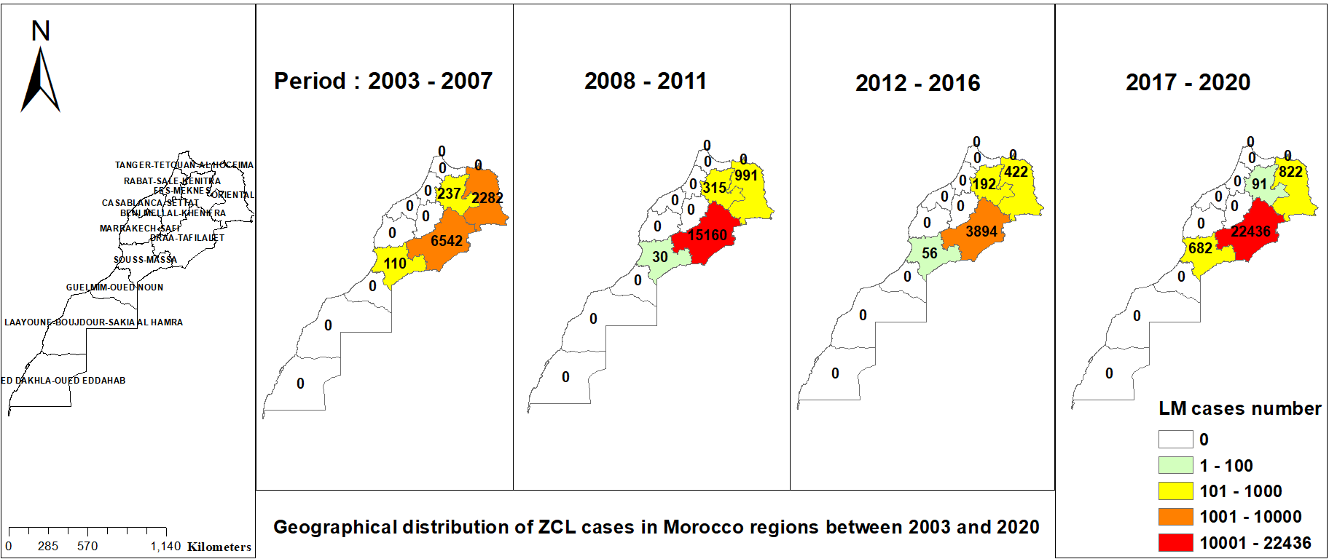
01
02
03
04
Methodology
Results
Conclusion
Objectives
Notes:
The geospatial analysis revealed that the spatial distribution of cutaneous leishmaniasis cases due to Leishmania major was predominantly concentrated in the southeastern and eastern regions of Morocco during the study period.

Slide 7
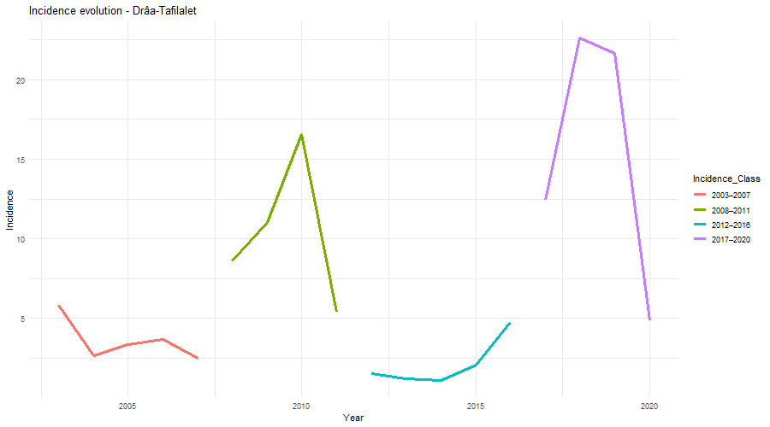
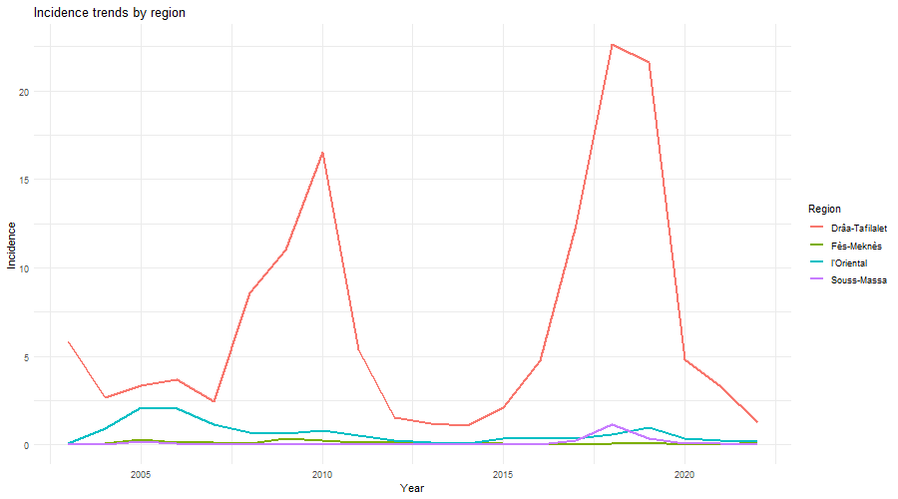
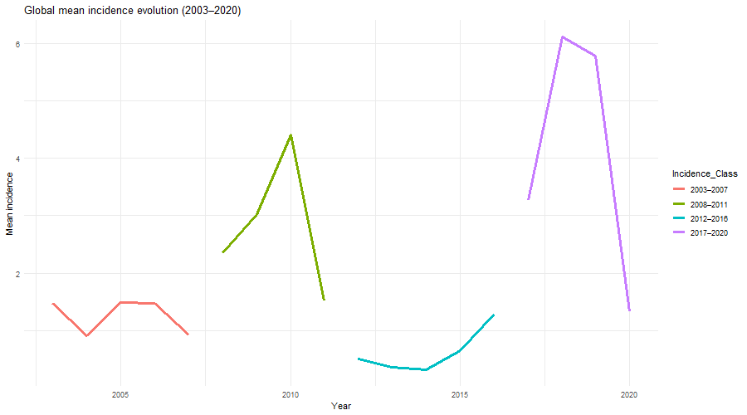
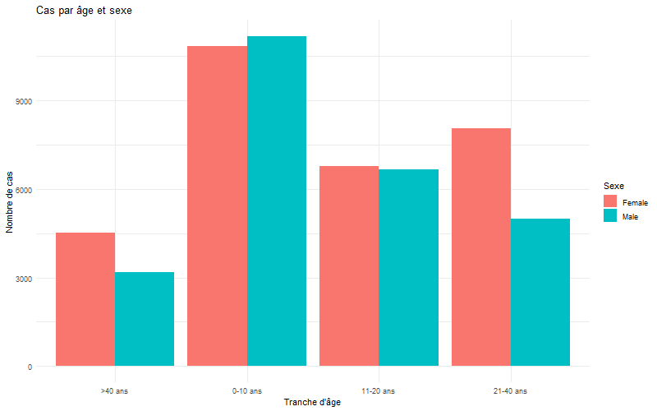
01
02
03
04
Methodology
Results
Conclusion
Objectives
Incidence evolution_Draâ-Tafilalet
Incidence trends by region
2017-2020
2008-2011
2003-2007
2012-2016
Globale mean Incidence evolution
Cases categories per sexe and age
F
M
>40
0 - 10
11 - 20
21 – 40
Notes:
The mean incidence showed a clear fluctuations over time, with two major peaks, one around 2008–2011 and another between 2017–2020. pronounced in Drâa-Tafilalet, which consistently records the highest incidence compared to other regions. With higher vulnerability has been observed among children under 10 with females showing slightly higher case numbers than males.

Slide 8
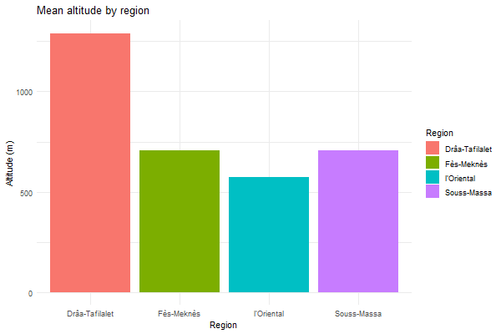
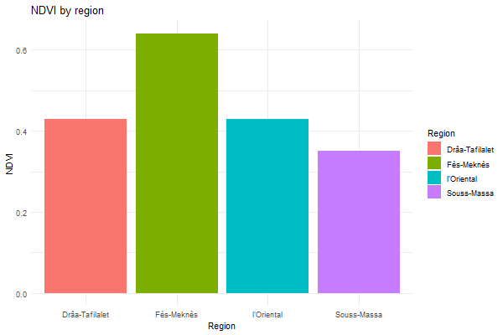
03
01
02
03
01
02
04
Methodology
Methodology
Results
Conclusion
Objectives
Objectives
Altitude by region
(r = 0.904, p < 0.001)
NDVI by region
(r = -0.181, p < 0.001)
Notes:
Concerning environmental factors, we found that Drâa-Tafilalet, which has the highest altitude, shows a highly significant correlation with disease incidence. In contrast, NDVI, reflecting vegetation cover, is highest in Fès-Meknès where has a low incidence. Overall, the pattern suggests that higher altitude is linked to an increased risk of disease and is strongly and posively associated with the incidence rates, whereas regions with higher denser vegetation, tend to show lower incidence rates, even though this trend was not statistically significant.

Slide 9
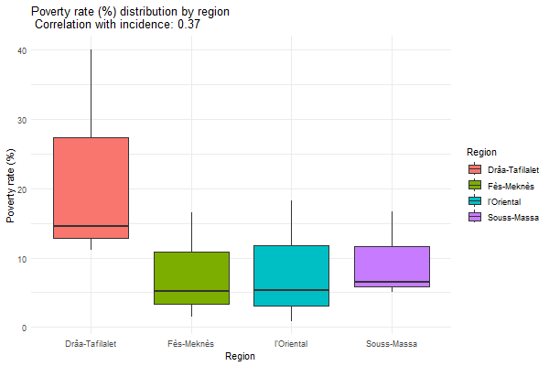
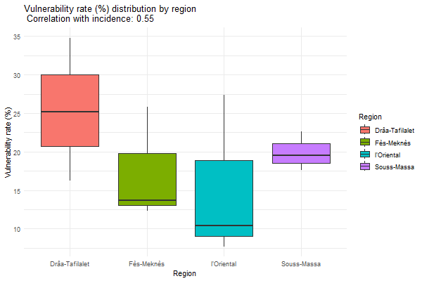
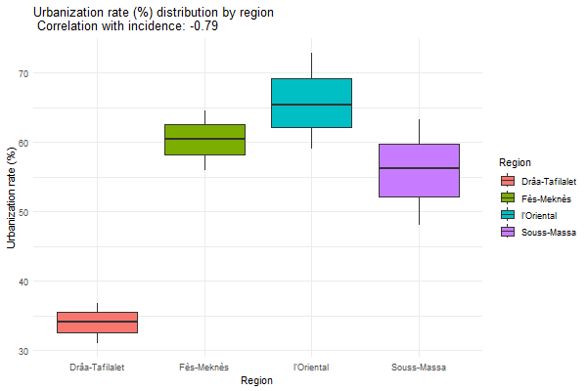
03
01
02
03
01
02
04
Methodology
Methodology
Results
Conclusion
Objectives
Objectives
Poverty rate (%) distribution by region
Correlation with incidence: 0.37
Vulnerability rate (%) distribution by region Correlation with incidence: 0.55
Urbanization rate (%) distribution by region Correlation with incidence: -0.79
Drâa-Tafilalet
Fés-Meknès
Oriental
Sous-Massa
Drâa-Tafilalet
Fés-Meknès
Oriental
Sous-Massa
Drâa-Tafilalet
Fés-Meknès
Oriental
Sous-Massa
Notes:
For social factors, we found that urbanization appears to have a strong inverse relationship with disease incidence and indicating that rural zones may increase the disease spread. On the other hand, factors such as poverty and vulnerability did not show a statistically significant association with disease incidence in our analysis.

Slide 10
01
02
03
04
Methodology
Results
Conclusion
Objectives
ZCL remains a major public health concern in Morocco, and continues to expand from established foci into previously non-endemic zones
Several foci in Draâ-Tafilalet region remain persistent hotspots and altitude emerging as a key determinant of ZCL spread in rural southeastern regions.
Strengthening surveillance systems in high-risk areas and integrating environmental determinants into predictive models could improve Morocco’s capacity to curb the spread of ZCL
Notes:
To taking home note Zoonotic cutaneous leishmaniasis remains a significant public health concern in Morocco, particularly in high-altitude rural areas like Drâa-Tafilalet. local ecological and demgraphic factors may play a key role in disease spread. SoTargeted prevention, strengthened surveillance, and further research into environmental drivers are essential to curb transmission effectively.

Slide 11
Thank you for your attention

